Slide 1

Data structures using C
Module 6 - Lecture II
Graphs
Prepared By
Ms. Smriti Sehgal

Slide 2

Operations on Graph
1. Union
If two graph G1 & G2 are given then $G_{1}∪ G_{2}$
Will be $V\left(G_{1}∪ G_{2}\right)=V\left(G_{1}\right)∪V(G_{2})$
&$E\left(G_{1}∪ G_{2}\right)=E\left(G_{1}\right)∪E(G_{2})$
A
e1
B
B
e5
e2
e4
$$∪$$
e4
E
C
D
D
e6
e3

Slide 3
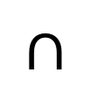
Module 6
Operations on Graph
Graph Terminology
-Graph Representation
-Warshall Algorithms
2. Intersection
If two graph G1 & G2 are given then $G_{1}∩ G_{2}$
-Different Operations on Graphs
-Graph Traversal
-Minimum
Will be $V\left(G_{1}∩ G_{2}\right)=V\left(G_{1}\right)∩V(G_{2})$
spanning tree
- Dijkstra shortest Path Algorithm
&$E\left(G_{1}∩ G_{2}\right)=E\left(G_{1}\right)∩E(G_{2})$
A
e1
B
B
e5
e2
e4
$$∩$$
e4
E
C
D
D
e6
e3

Slide 4

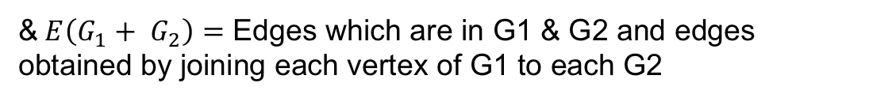
Module 6
Operations on Graph
Graph Terminology
-Graph Representation
-Warshall Algorithms
3. Sum of two graph
If two graph G1 & G2 are given then $G_{1}+G_{2}$
-Different Operations on Graphs
-Graph Traversal
-Minimum
Will be $V\left(G_{1}+ G_{2}\right)=V\left(G_{1}\right)+V(G_{2})$
spanning tree
- Dijkstra shortest Path Algorithm
&$E\left(G_{1}+ G_{2}\right)=$ Edges which are in G1 & G2 and edges obtained by joining each vertex of G1 to each G2
A
B
e2
$$+$$
e4
C
D
e3
D

Slide 5

Module 6
Operations on Graph
Graph Terminology
-Graph Representation
-Warshall Algorithms
3. Ring Sum
If two graph G1 & G2 are given then $G_{1}⊕G_{2}$
-Different Operations on Graphs
-Graph Traversal
-Minimum
Will be $V\left(G_{1}⊕ G_{2}\right)=V\left(G_{1}\right)∪ V(G_{2})$
spanning tree
- Dijkstra shortest Path Algorithm
&$E\left(G_{1}⊕ G_{2}\right)=E\left(G_{1}\right)∪E\left(G_{2}\right)−E\left(G_{1}\right)∩E(G_{2})$
edges either in G1 or G2 but not in both
A
e1
B
B
e5
e2
e4
$$∪$$
e4
E
C
D
D
e6
e3

Slide 6
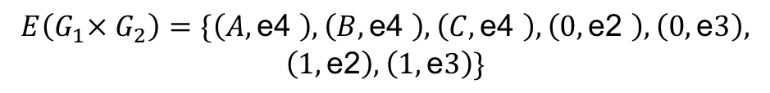

Module 6
Operations on Graph
4. Product
If two graph G1 & G2 are given then $G_{1}×G_{2}$
Graph Terminology
-Graph Representation
-Warshall Algorithms
Will be $V\left(G_{1}× G_{2}\right)=V\left(G_{1}\right)× V(G_{2})$
-Different Operations on Graphs
-Graph Traversal
-Minimum
&$E\left(G_{1}× G_{2}\right)=E\left(G_{1}\right)×E\left(G_{2}\right)∪E\left(G_{2}\right)×E(G_{1})$
spanning tree
- Dijkstra shortest Path Algorithm
$$V\left(G_{1}× G_{2}\right)=\{\left(A,0\right),\left(A,1\right),\left(B,0\right),\left(B,1\right),\left(C,0\right),\left(C,1\right)\}$$
A
$$E\left(G_{1}× G_{2}\right)=\{\left(A,\text{e}\text{4 }\right),\left(B,\text{e}\text{4 }\right),\left(C,\text{e}\text{4 }\right),\left(0,\text{e}\text{2 }\right),\left(0,\text{e}3\right),$$
$$\left(1,\text{e}\text{2}\right),\left(1,\text{e}3\right)\}$$
0
e2
A, 0
A, e4
A, 1
$$×$$
e4
B
0, e2
1, e2
1
B, 0
B, e4
B, 1
e3
C
0, e3
1, e3
C, 0
C, e4
C, 1

Slide 7


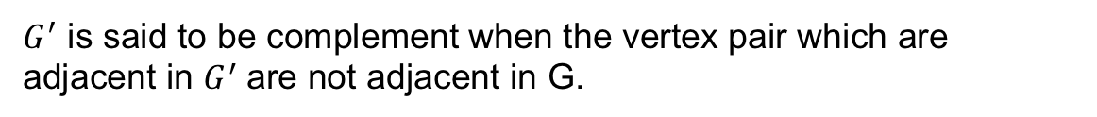
Module 6
Operations on Graph
Graph Terminology
-Graph Representation
-Warshall Algorithms
5. Complement
$${G→G}^{′}$$
-Different Operations on Graphs
-Graph Traversal
-Minimum
$G^{′}$ is said to be complement when the vertex pair which are adjacent in $G^{′}$are not adjacent in G.
spanning tree
- Dijkstra shortest Path Algorithm
A
A
0
1
0
1
B
C
B
C
2
2
$$G$$
$$G^{′}$$

Slide 8
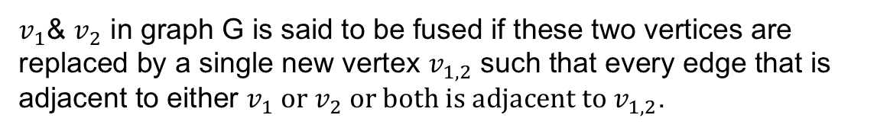
Module 6
Operations on Graph
6. Fusion / Merged / Identified
Graph Terminology
-Graph Representation
-Warshall Algorithms
-Different Operations on Graphs
-Graph Traversal
-Minimum
$v_{1}$& $v_{2}$ in graph G is said to be fused if these two vertices are replaced by a single new vertex $v_{1,2}$ such that every edge that is adjacent to either $v_{1}$or $v_{2}$or both is adjacent to $v_{1,2}$.
spanning tree
- Dijkstra shortest Path Algorithm
$$Consider the graph below merge A \& D$$
A
A, D
D
B
C
B
C

Slide 9
Graph Traversal
Graph traversal is technique used for searching a vertex in a graph. The graph traversal is also used to decide the order of vertices to be visit in the search process.
DFS (Depth First Search)
BFS (Breadth First Search)

Slide 10
DFS (Depth First Search)
DFS traversal of a graph, produces a spanning tree as final result.
Spanning Tree is a graph without any loops.
We use Stack data structure with maximum size of total number of vertices in the graph.
Back tracking is coming back to the vertex from which we came to current vertex.

Slide 11
DFS (Depth First Search) Work-Through
Visited Array
Stack
F
C
A
B
C
D
E
F
G
H
√
A
√
B
D
√
H
√
B
A
G
E
√
H
√
G
C
F
√
E
√
D
The order nodes are visited:
D
No unvisited nodes adjacent to F. Backtrack.
No nodes adjacent to C; cannot continue ➔ backtrack, i.e., pop stack and restore previous state
F is unvisited and is adjacent to D. Decide to visit F next.
No unvisited nodes adjacent to D. Backtrack.
Back to D – C has been visited, decide to visit E next
Visit D
Consider nodes adjacent to D, decide to visit C first (Rule: visit adjacent nodes in alphabetical order)
Nodes D and H are adjacent to G. D has already been visited. Decide to visit H.
Nodes A and B are adjacent to H. Decide to visit A next.
Only G is adjacent to E, So visit G
Only Node B is adjacent to A. Decide to visit B next.
Stack is empty. Depth-first traversal is done.
Visit C
H
F
No unvisited nodes adjacent to B, A, H, G, E. Backtrack (pop the stack).
C
G
A
B
E

Slide 12
Algorithm for DFS
Step 1: Define a Stack of size total number of vertices
Step 2: Select any vertex as starting point. Visit that vertex and push it on to the Stack.
Step 3: Visit any one of the adjacent vertex of the vertex which is at top of the stack which is not visited and push it on to the stack.
Step 4: Repeat step 3 until there are no new vertex to be visit from the vertex on top of the stack.
Step 5: When there is no new vertex to be visit then use back tracking and pop one vertex from the stack.
Step 6: Repeat steps 3, 4 and 5 until stack becomes Empty. When stack becomes Empty, then produce final spanning tree by removing unused edges from the graph

Slide 13
Pseudo code for DFS
DFS(input: Graph G)
{
Stack S; Integer x, y;
while (G has an unvisited node x)
{
visit(x);
push(x,S);
while (S is not empty)
{
t := top(S);
if (t has an unvisited neighbor y)
visit(y);
push(y,S);
else
pop(S);
}
}
}

Slide 14
Breadth First Search Traversal
BFS traversal of a graph, produces a spanning tree as final result.
Spanning Tree is a graph without any loops.
We use Queue data structure with maximum size of total number of vertices in the graph

Slide 15
Example
1. Choose any random vertex as start point.
2. Insert that vertex in a Queue
r
s
t
u
3. Insert adjacent neighbour in a Queue and Deque
∞
∞
∞
∞
1
0
2
3
4. Next vertex in queue is selected again step 3 is carried out. Continue till all vertex been visited
∞
∞
∞
∞
2
1
2
3
v
w
x
y
5. We have visited all vertex and also queue is empty.
Q[8]
s
w
r
t
x
v
u
y
6. The path we followed is the final Spanning tree.

Slide 16
Algorithm for BFS
• Rule 1 − Visit adjacent unvisited vertex. Mark it visited. Display it. Insert it in a queue.
• Rule 2 − If no adjacent vertex found, remove the first vertex from queue.
• Rule 3 − Repeat Rule 1 and Rule 2 until queue is empty.

Slide 17
Pseudo code for DFS
BFS(input: graph G)
{
Queue Q; Integer x, z, y;
while (G has an unvisited node x)
{
visit(x); Enqueue(x,Q);
while (Q is not empty)
{
z := Dequeue(Q);
for all (unvisited neighbor y of z)
{
visit(y);
Enqueue(y,Q);
}
}
}
}

Slide 18
Complexity Analysis
Queuing time is O(V) and scanning all edges requires O(E)
Overhead for initialization is O (V)
So, total running time is O(V+E)

Slide 20


